Slide 1


Recomendaciones de Videojuegos: Comparación de Modelos
Laboratorio de Datos 1C2022
Grupo 15
Integrantes:
Manuel Horn
Martín Acuña
Facundo Solar
Ignacio Rodriguez Sañudo

Slide 2
IDEA
Sistemas de recomendación basados en las reseñas de usuarios
Preguntas disparadoras:
¿Nos servirá analizar reseñas para recomendarle el juego a un amigo?
¿Cuánta información me puede proveer analizar opiniones ajenas cuando busco elegir una recomendación?
¿Podemos construir un modelo que funcione ante nuevos comentarios fuera del dataset?

Slide 3


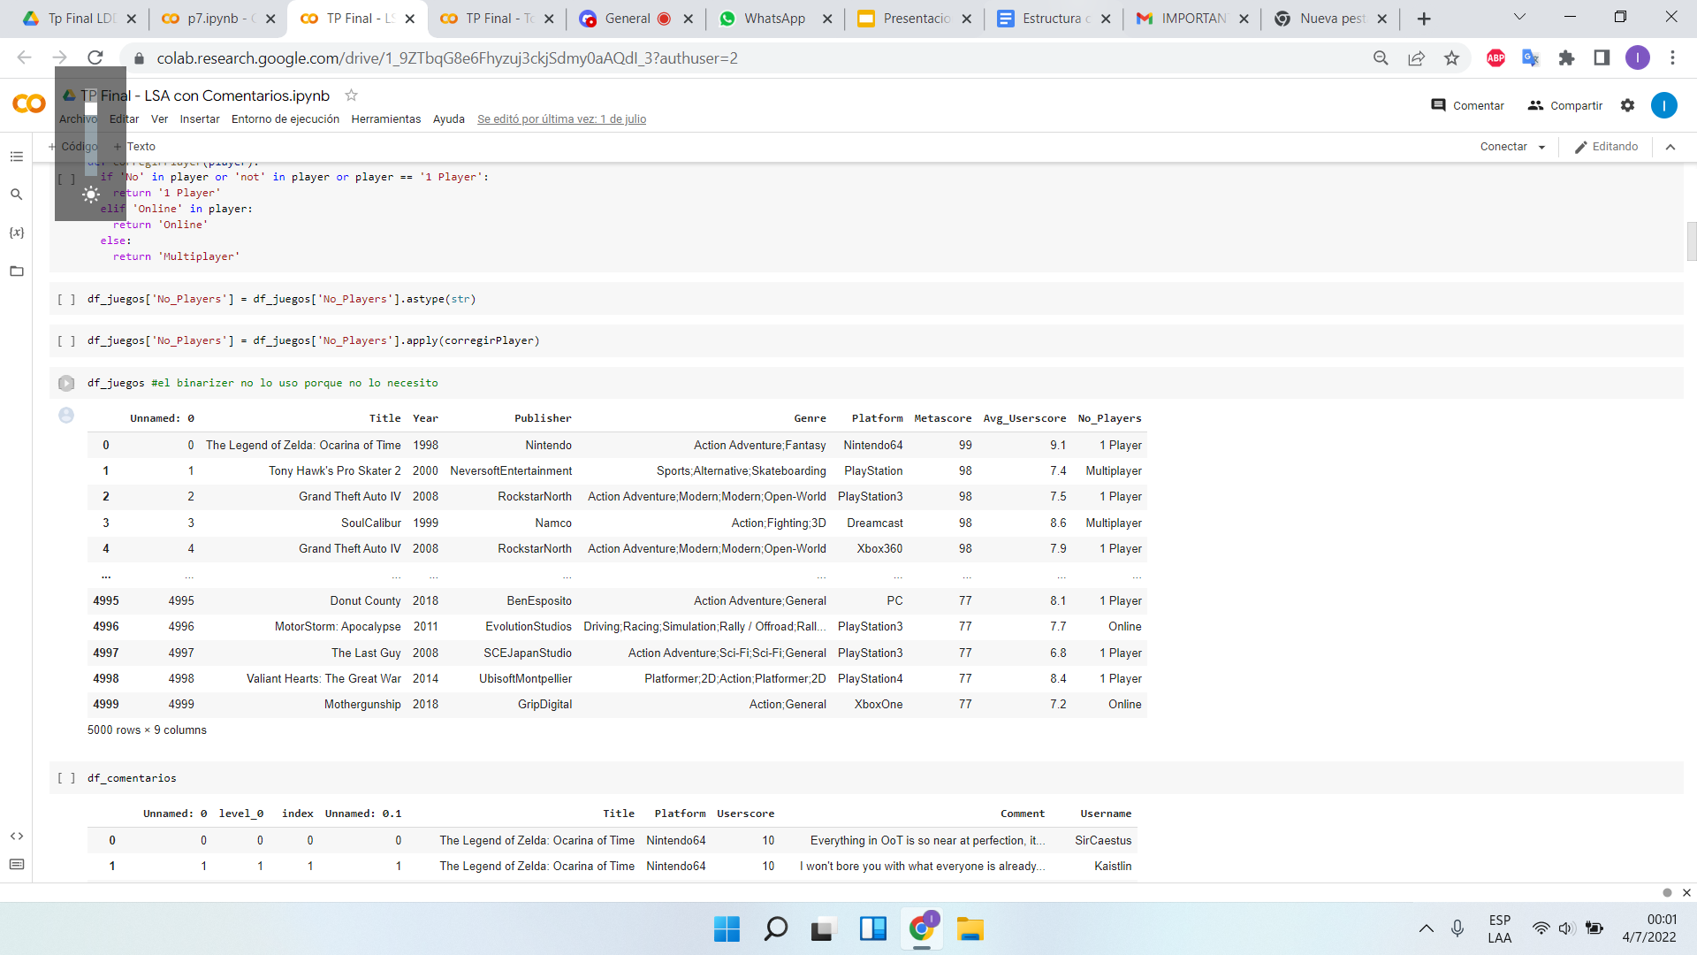
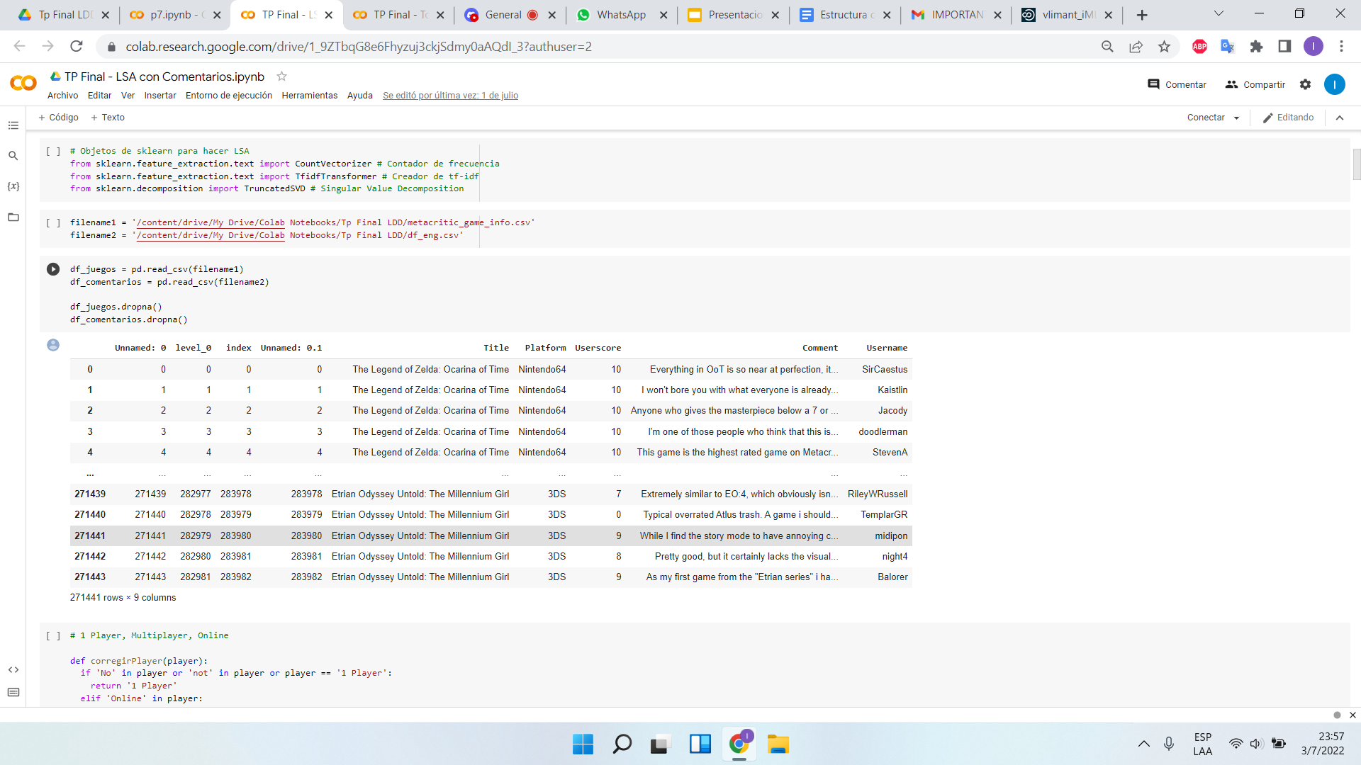
Sobre el Dataset

Slide 4


Reseñas
“Everything in OoT is so near at perfection, it’s really no wonder that this game has such a huge fanbase and is so highly rated among players and critics.”
“Fantastic atmosphere, great graphics that stands the test of time, great storyline, intelligent puzzles and a lot of action make Half-Life 2 one of the best FPS games ever. I liked the classic first part too but this is the one that really made me a fan.”
“Best need for speed game i have ever played”
“I want my money back....Took everything we loved in diablo 2 and flushed it down the toilet....Really blizzard.. Everyone; the game is no where near worth it.”
“Weak campaign which is very boring. But the multiplayer makes up with the realistic war with huge maps but still fastish pace with the vehicles overall”
“EA selling same game from year to year, only slightly improving graphics and changes interface. Same scripts, same mechanics, same bugs. If you bought fifa 14 and you didn't liked, then don't buy this game, it's not much different.”
“Ubisoft disappointing us as always. It's just a bad GTA copy but with hackers and full of bugs”

Slide 5
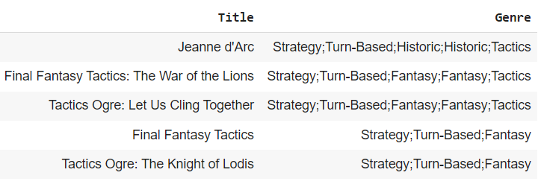
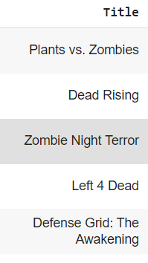

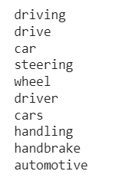
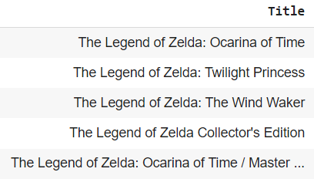
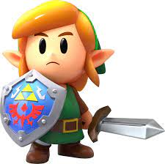
Modelo LSA
Por Título
Clustering por términos
saga extensa
sin saga

Slide 6
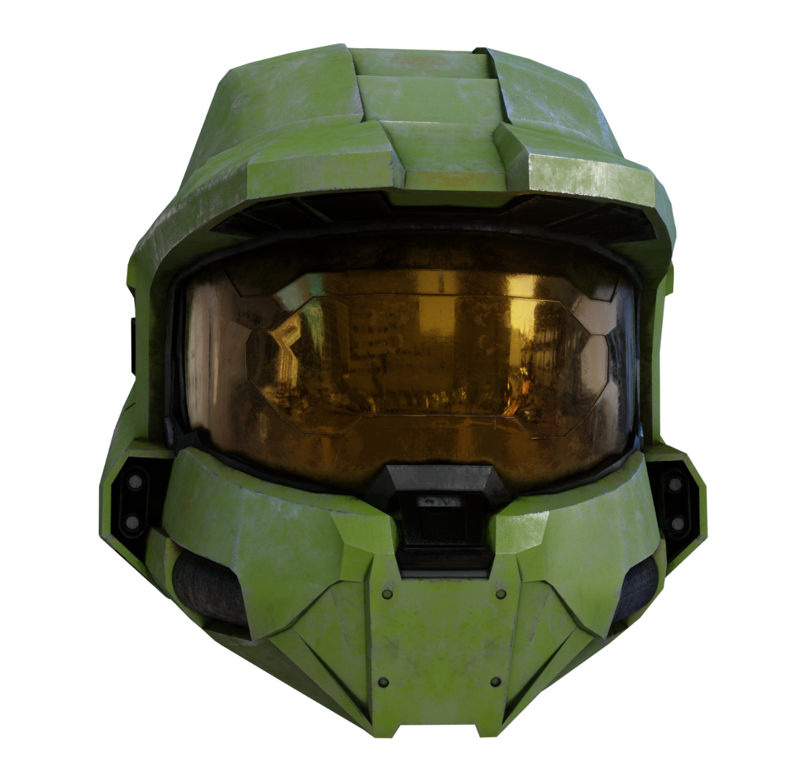
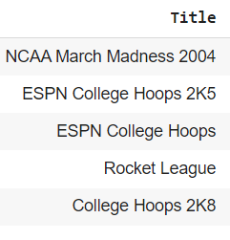
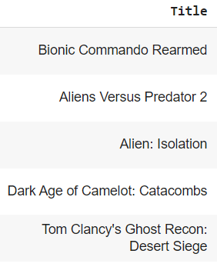
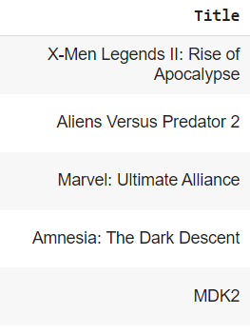
Modelo LSA
Por Comentario
Halo 5: Guardians
Saga extensa
Reseña real externa:
“The narrative is suitably epic and grandstanding and makes a bold decision with a long-standing character but takes itself far too seriously. Which, for a game about purple aliens, planet destroying super weapons and bionic soldiers, seems a little off-key.”
Palabras clave:
“Basketball league three Jordan clutch ball Lakers”
Simulado:
“This game scared me a lot, some characters were terrifying.”
Recomendación por tópico
Tom Hoggins
Telegraph

Slide 7
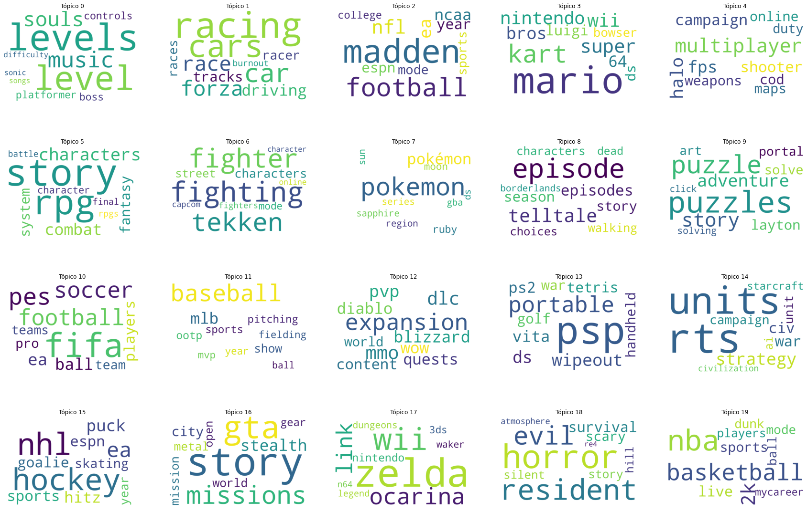
Tópicos

Slide 8
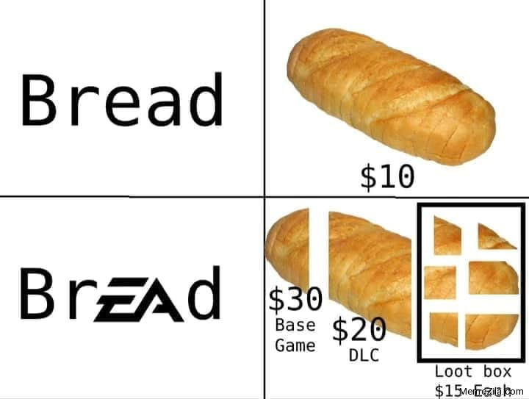
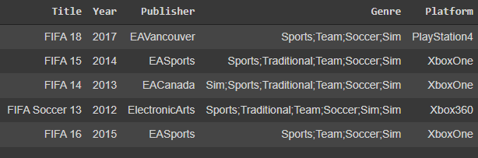
Esta recomendación siempre es buena?
“EA giving us the same game every year. I will never buy a fifa again”

Slide 9
Positividad/Negatividad en comentarios
Buena review: Recomendamos
“Fantastic atmosphere, great graphics that stands the test of time, great storyline, intelligent puzzles…”
Mala review: No recomendamos
“Ubisoft disappointing us as always. It's just a bad GTA copy but with hackers and full of bugs”

Slide 10
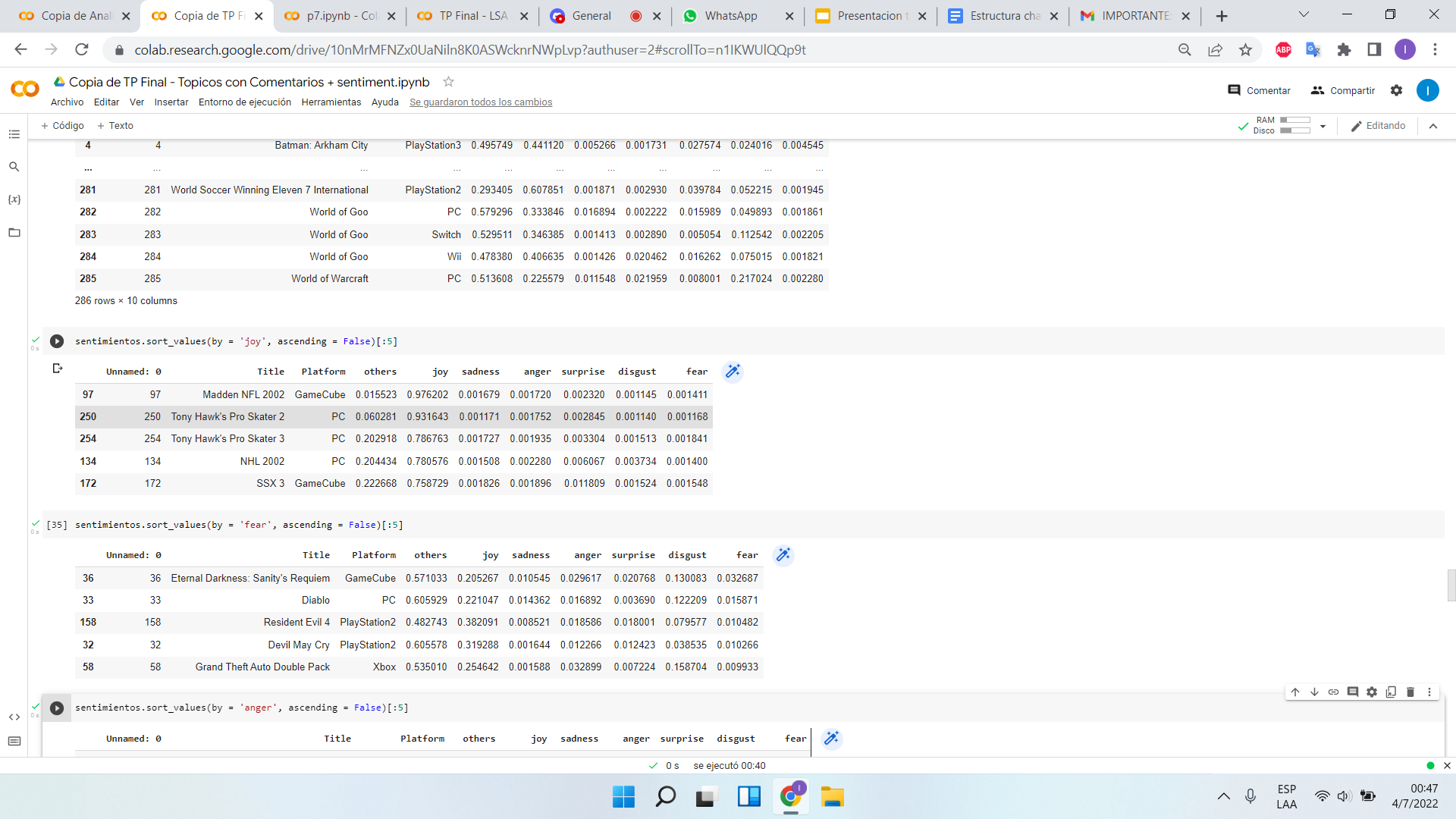
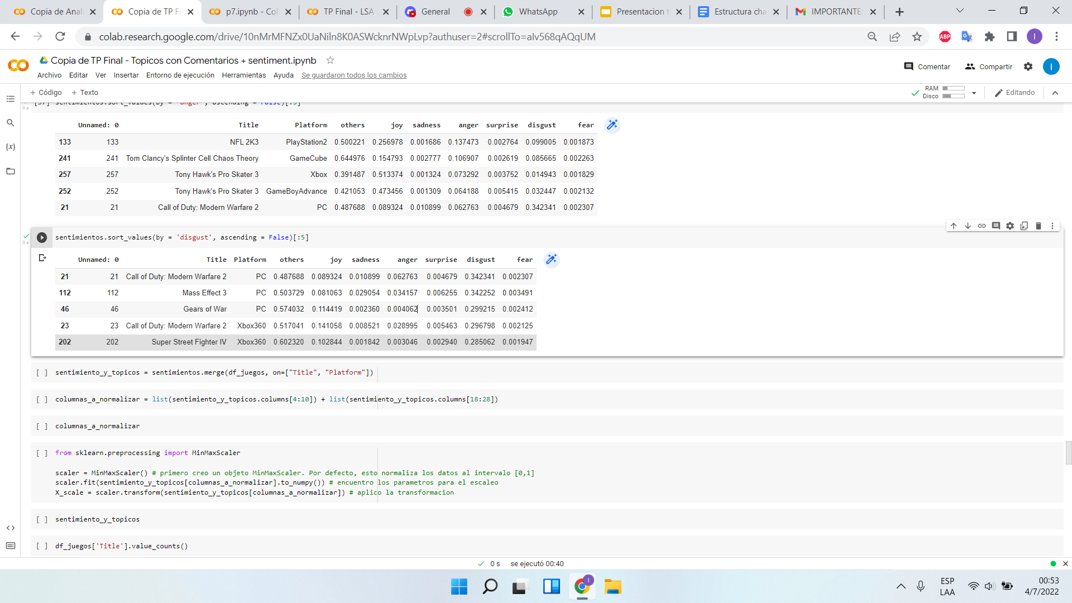
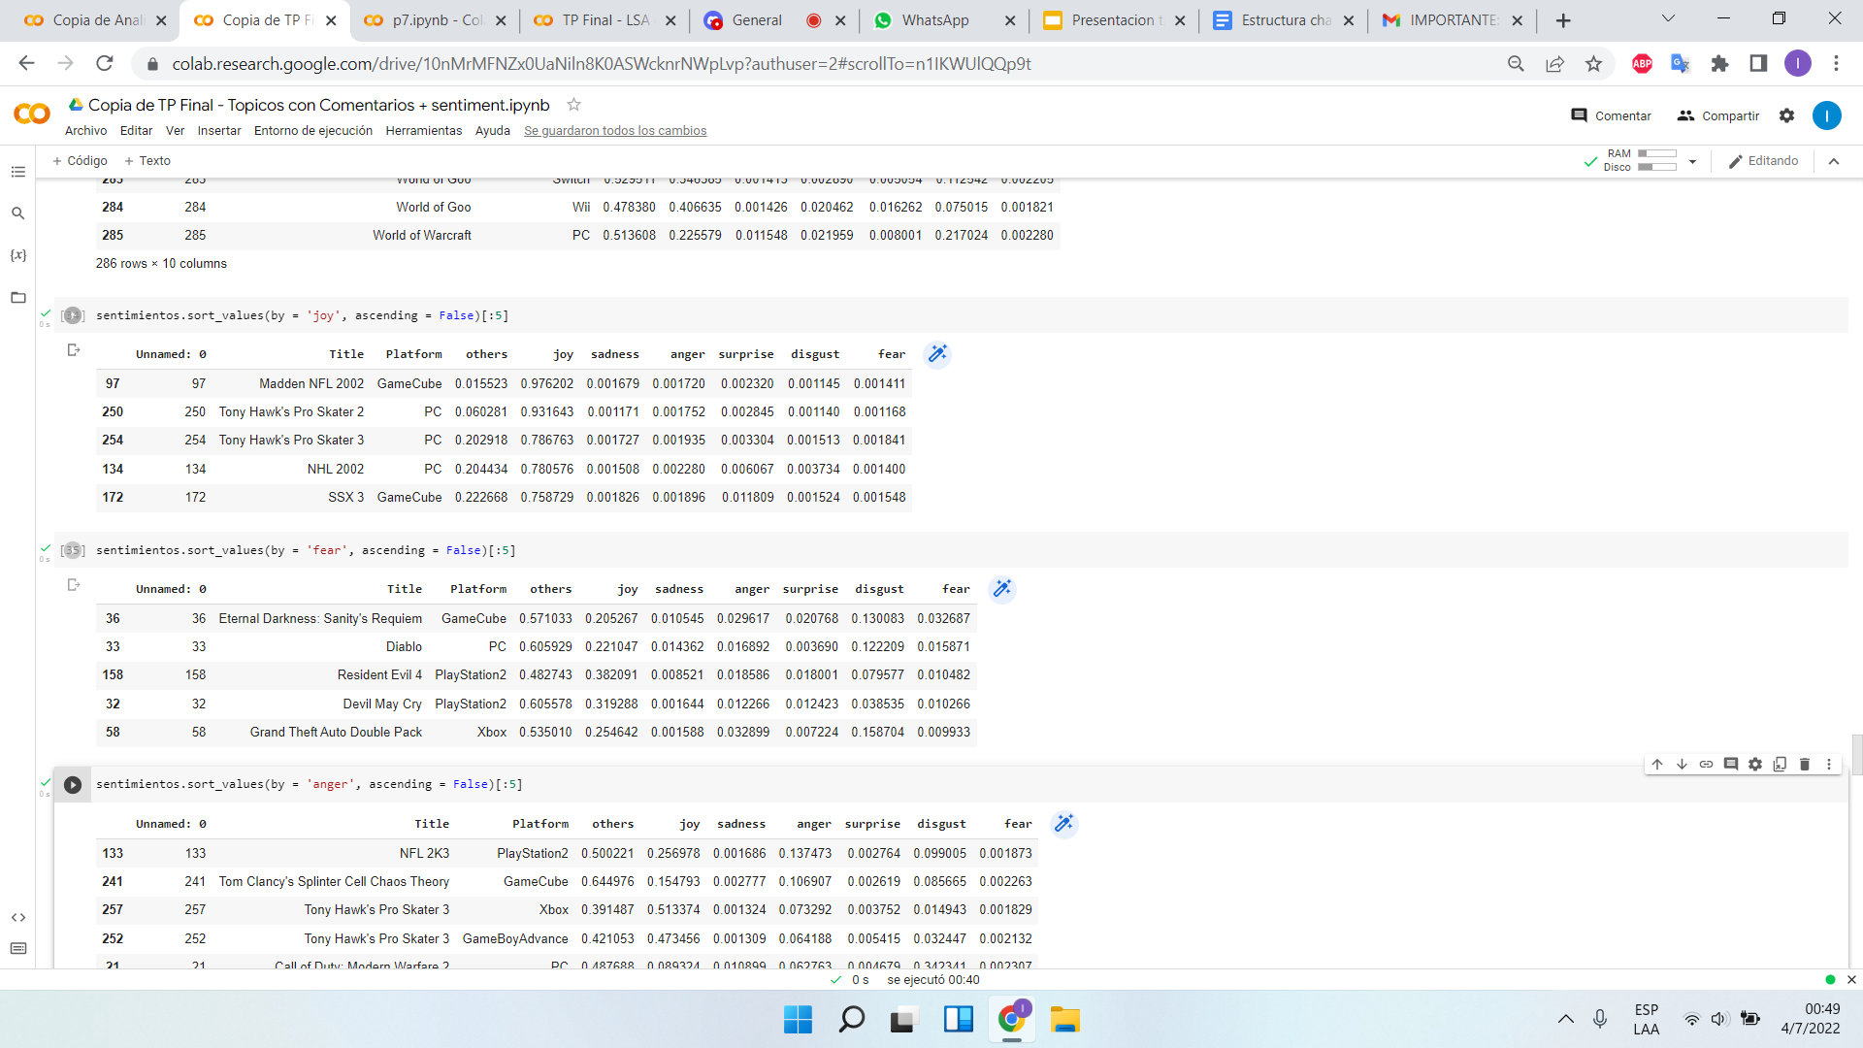
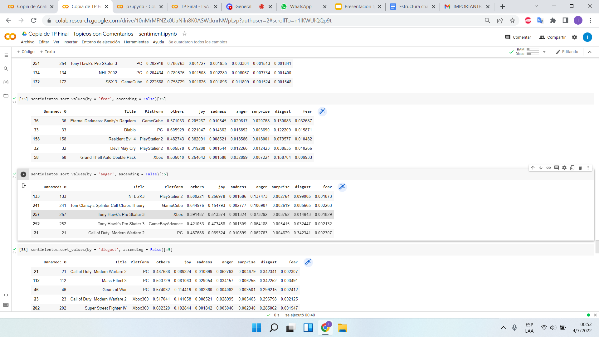
Sentiment Analysis
TOP JUEGOS POR EMOCIÓN
Alegría
Disgusto
Miedo
Enojo

Slide 11
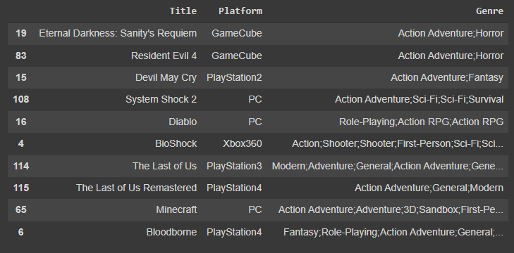
Idea para agregar diversidad a las recomendaciones
"Everything in this game is dark and scary. I remember playing this as a kid and being terrified"
Usar el sentiment analysis que obtuvimos como medida de similaridad con Nearest Neighbors.

Slide 12
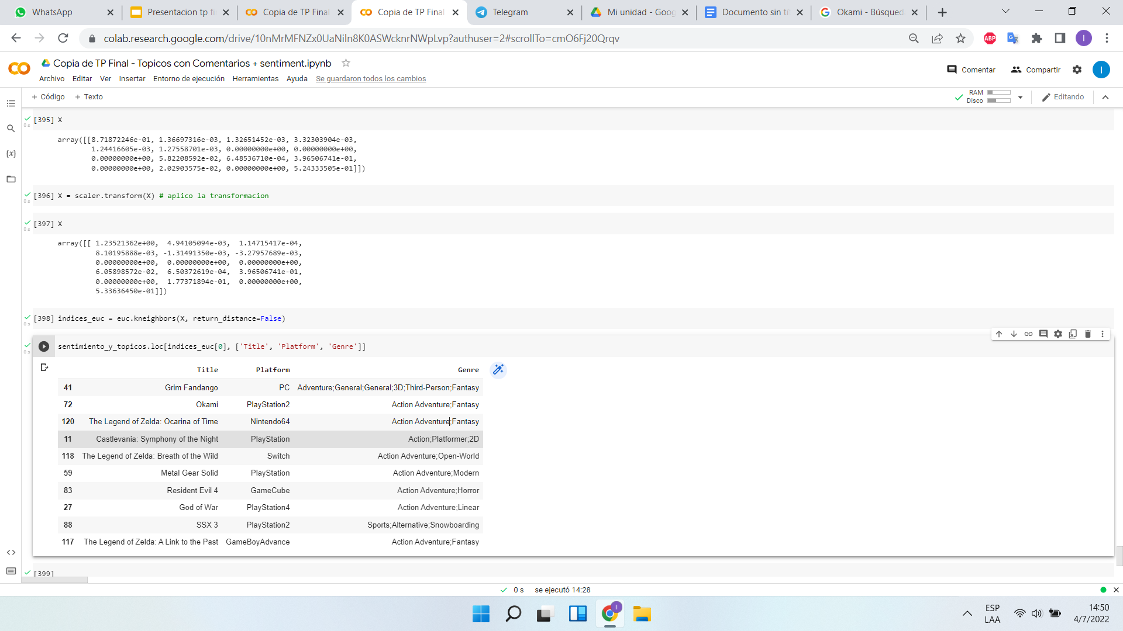
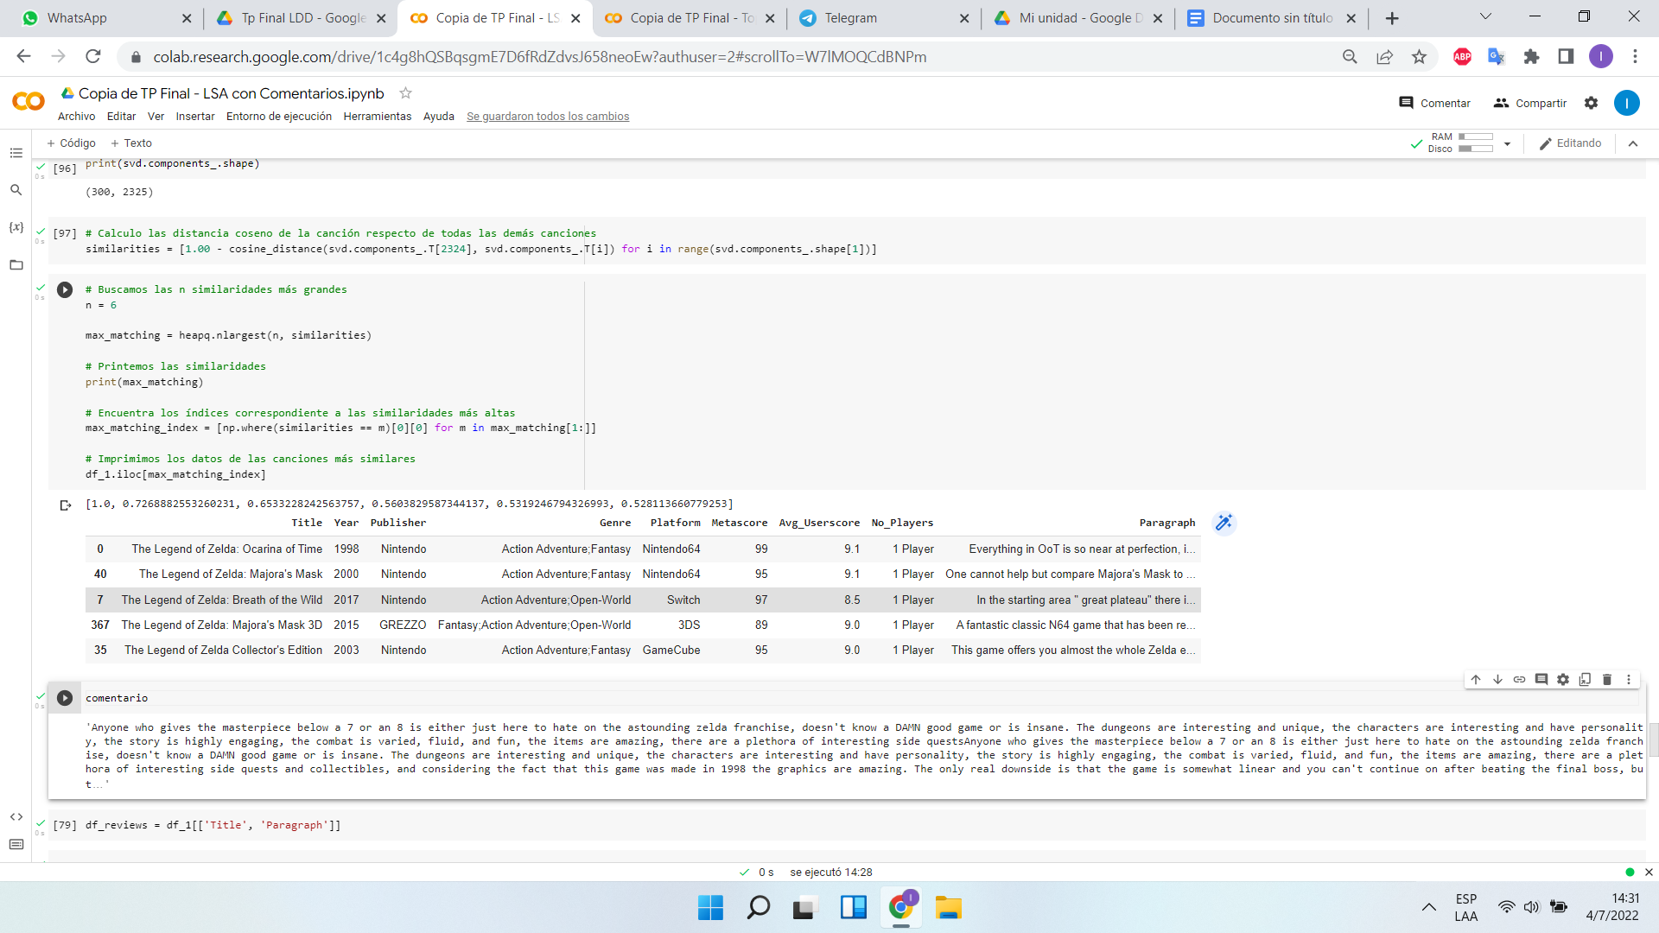
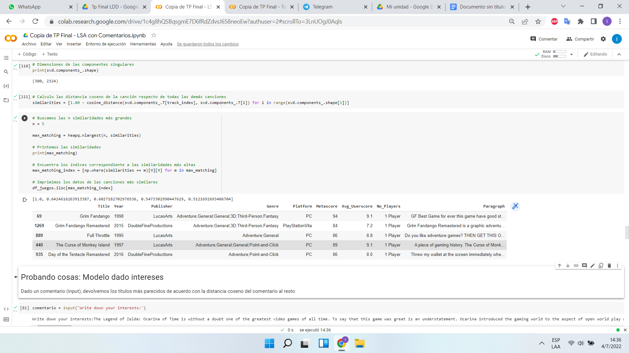
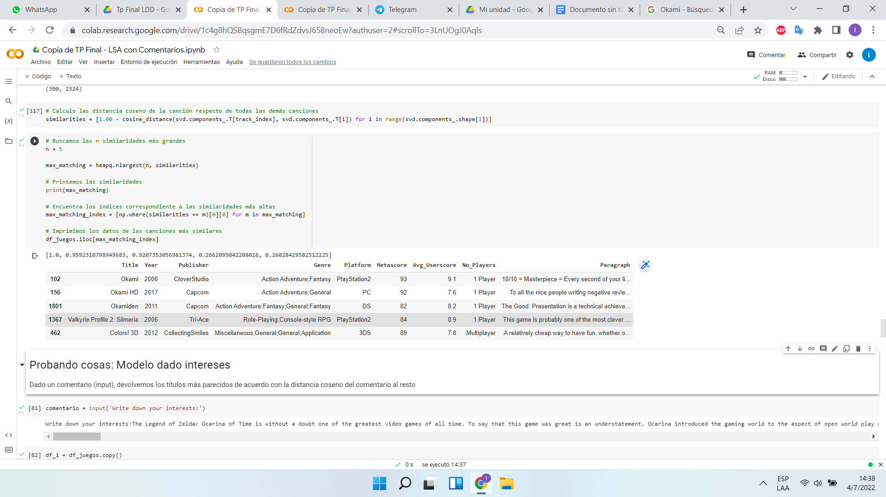
Emociones + Tópicos
Recomendaciones con LSA
LSA

Slide 13
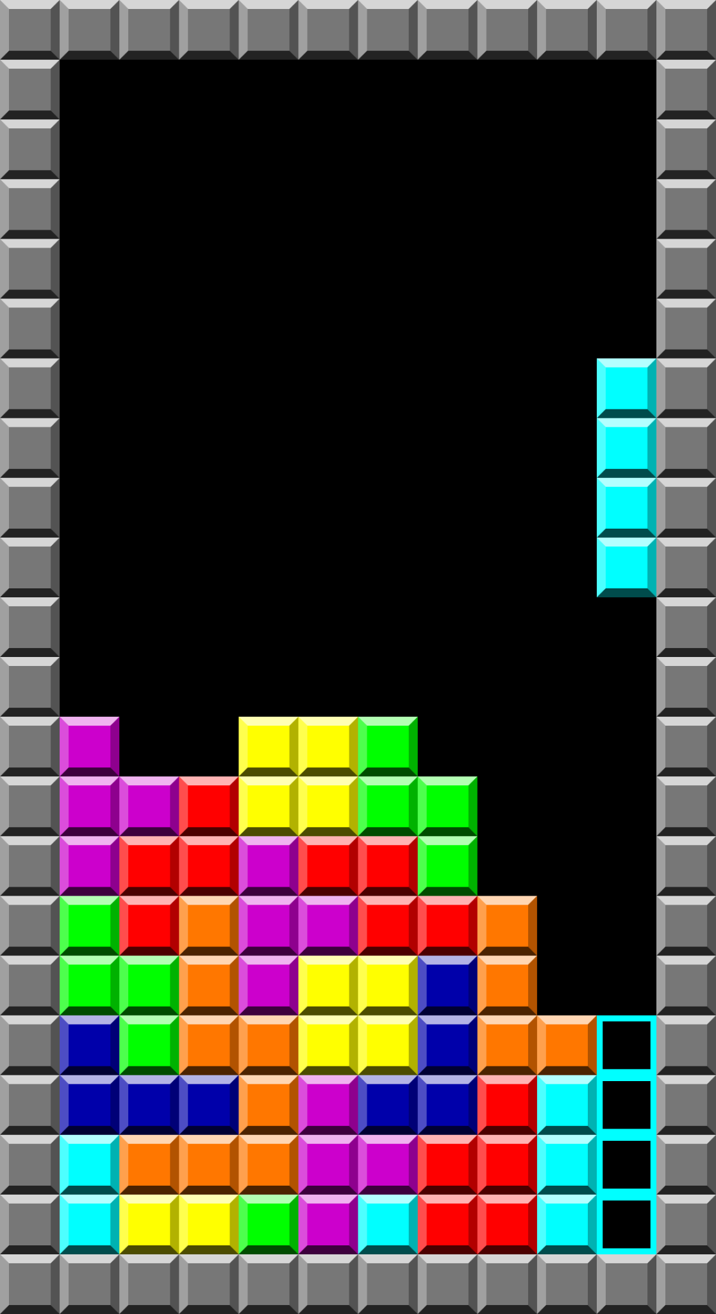

Gracias por su atención
¿Preguntas?

